Slide 1
Asset Management for the
All-Kanns Life Insurance
Financial Engineering | Prof. Dr. Stefan Tilch
Group 3b | 1-year 99% VaR, EUR swap curve as of 2 Sep 2026
Ben Lösche · David Wolter · Kira Clara Bøgeskov Pedersen · Ishita Pandey
Manuel Blasco Blázquez · Wiktor Murawski · Zhuoran Wang

Slide 2
Executive Summary
1
The mandate, our approach and the outcome our model produces
THE MANDATE AT A GLANCE
THE ASK
THE APPROACH
THE RESULT
THE RISK
€5.0bn → ~€10bn
2 sleeves
~5.9% p.a.
€0.85bn
100,000-policyholder book, contributions €0.5bn/yr for 10y, 15-year horizon
Liability-matching bond book + surplus-funded return portfolio, split re-struck yearly
Median 15-year IRR (money-weighted); median funded ratio 205% at year 15
1-year 99% surplus VaR after the receiver-IRS overlay (€1.21bn before)
In short: a cash-flow- and key-rate-matched bond book clears the €11.3bn guaranteed floor; the surplus funds an aggressive, diversified return portfolio, with a 90/10 policyholder profit share from year 15. A par receiver-IRS overlay (no cash outlay) closes the residual duration gap.
• Funding waterfall t=0 → €5.0bn into the liability-matching bond book; t=1..10 → €0.5bn/yr into the return portfolio.
• Every USD sleeve is swapped back to EUR; accounting basis IAS; regulatory frame Solvency II / BaFin AnlV.
CLIENT SITUATION | OUR SELLING POINTS | STRATEGIC CHALLENGES & MARKET OVERVIEW | PRODUCT STRATEGY | PORTFOLIO RESULTS | WHAT HAPPENS WITH THE UPSIDE

Slide 3
SECTION 01
Client Situation / Needs
The book, the guarantee, the payout election and the regulatory frame

Slide 4
Client Profile and Portfolio Structure
2
100,000 policyholders, one age cohort, a 10-year contribution horizon
SET-UP OF ALL-KANNS
Baseline & liabilities
Cash flow to the insurer
• Book value today €5.0bn (100,000 × €50,000).
• Contributions €5,000 per person per year, end of year, for 10 years → €0.5bn/yr.
• One cohort all insured are 50 (50% male); no deaths assumed in the first 15 years.
• Guarantee 1.0% p.a. Höchstrechnungszins on every euro paid in, to year 15.
• Election at year 15 lump sum or a monthly pension (≥10 years); base case an even 50/50 split.
• Accounting / regulation IAS; Solvency II SCR (99.5%); BaFin AnlV quantitative limits.
0 (age 50)
existing assets €5.0bn
1 – 10 (51–60)
+ €0.5bn per year
11 – 14 (61–64)
no contribution, no payment
15 (65)
guaranteed benefits begin
16 – 50
pension tail for annuitants
Sources: assignment brief; results/optimization_summary.txt (guaranteed accumulated value €11.303bn at year 15).
CLIENT SITUATION | OUR SELLING POINTS | STRATEGIC CHALLENGES & MARKET OVERVIEW | PRODUCT STRATEGY | PORTFOLIO RESULTS | WHAT HAPPENS WITH THE UPSIDE

Slide 5
Defined Payout Structure
3
Contributions run 10 years; the year-15 election sets the payout shape
PAYOUT OPTIONS AT YEAR 15
Lump sum
Monthly pension (annuity)
• Accumulated guaranteed capital paid as a single amount at year 15.
• Relationship ends – no residual risk to us after payment.
• A stream for life, guaranteed for at least 10 years (to year 25).
• Beyond year 25 it continues only for survivors – longevity risk sits with us.
CHOICE AT YEAR 15
CONTRIBUTION INFLOW
NO DEATHS YR 1–15
50 / 50
€0.5bn/yr
clean
Base-case split; stressed ±25pp (results/policyholder_choice_scenarios.csv)
€5,000 × 100,000, years 1–10, end of year
Mortality only enters the pension tail from year 16
Pension tail modelled age 65→99 (Destatis Sterbetafel 2022/24), minimum 10 years guaranteed.
CLIENT SITUATION | OUR SELLING POINTS | STRATEGIC CHALLENGES & MARKET OVERVIEW | PRODUCT STRATEGY | PORTFOLIO RESULTS | WHAT HAPPENS WITH THE UPSIDE

Slide 6
SECTION 02
Our Expertise and Goals For You
Why a liability-precision manager, not a generalist balanced fund

Slide 7
Why All-Kanns Should Choose Us
4
Four reasons, matched to the mandate
OUR EDGE
Liability-precision matching
IAS-aware by design
• One cohort, one contribution schedule – a genuine cash-flow + key-rate match.
• Assets phased to the accumulation, bridge and payout stages of your liability.
• Built around fair-value volatility, not return alone – reported earnings protected.
• Duration and key-rate DV01 calibrated to keep P&L / OCI swings defensible.
Embedded-option expertise
Scale and built-in margin
• We price the year-15 lump-sum-vs-pension election like a callable bond.
• Structural insight most generalist managers overlook.
• €5.0bn today → c.€10bn by year 10 – institutional pricing on every trade.
• Engineered to clear the 1.0% guarantee with room to spare on the median path.
Objective: a partner who thinks like an ALM actuary and invests like an institutional asset manager.
CLIENT SITUATION | OUR SELLING POINTS | STRATEGIC CHALLENGES & MARKET OVERVIEW | PRODUCT STRATEGY | PORTFOLIO RESULTS | WHAT HAPPENS WITH THE UPSIDE

Slide 8
SECTION 03
Considerations and Market Overview
Allocation management, the regulatory frame and the European backdrop

Slide 9
Considerations When Implementing the Strategy
5
Balancing liquidity, long-term return and regulation across a 15-year horizon
KEY STRATEGIC CHALLENGES
Allocation management
What each challenge demands
• Cash buffer ahead of the year-15 lump-sum spike – no forced asset sales.
• Stable, liquid book in the years 11–15 bridge.
• Weight limits across asset classes for diversification.
• Sufficient cash / T-bills ahead of lump-sum payouts to meet benefits without selling into weakness.
• A stable, highly liquid portfolio through the residual bridge period to safeguard capital.
• Operating inside the AnlV investable universe and internal policy limits.
• Single-debtor ≤ 5% and corporate-group ≤ 3% of guarantee assets – concentration control.
• Solvency II capital efficiency weighed against every return-seeking position.
CLIENT SITUATION | OUR SELLING POINTS | STRATEGIC CHALLENGES & MARKET OVERVIEW | PRODUCT STRATEGY | PORTFOLIO RESULTS | WHAT HAPPENS WITH THE UPSIDE

Slide 10
Quantitative Capital Requirements – Solvency II
6
Directive 2009/138/EC – the frame our internal limits sit inside
ASSESSMENT PARAMETERS
SCR
Capital to absorb unexpected loss over one year at 99.5% confidence (1-in-200); standard formula or internal model; own funds must cover it at all times.
MCR
Hard floor with an absolute minimum; always between 25% and 45% of the SCR.
Valuation
Assets and liabilities at market-consistent fair value; technical provisions = best-estimate liabilities + risk margin.
Our internal steering measure is a 1-year 99% VaR (below); the 99.5% SCR remains the binding regulatory test.
CLIENT SITUATION | OUR SELLING POINTS | STRATEGIC CHALLENGES & MARKET OVERVIEW | PRODUCT STRATEGY | PORTFOLIO RESULTS | WHAT HAPPENS WITH THE UPSIDE

Slide 11
IAS Accounting Impact on the Balance Sheet
7
Accounting treatment steers the book toward stable, long-duration, transparent assets
IAS STANDARD → PORTFOLIO IMPLICATION
Investment valuation
HTM / AFS / FVTPL rules change how market moves hit P&L vs OCI
Favours stable long-term bonds over volatile short-term holdings
Liability measurement
Future obligations discounted (guarantee accrues at 1.0%; market value on the EUR curve)
Match asset duration and key-rate profile to the liability
Revenue recognition
Income recognised when earned, not on mark-to-market
Predictable, steady running yield aligned to payouts
Reporting & transparency
Low-volatility results and disclosure of key assumptions required
Transparent, low-turnover portfolio; documented stress + VaR
Not accounting advice.
CLIENT SITUATION | OUR SELLING POINTS | STRATEGIC CHALLENGES & MARKET OVERVIEW | PRODUCT STRATEGY | PORTFOLIO RESULTS | WHAT HAPPENS WITH THE UPSIDE

Slide 12
Eligible Asset Classes – BaFin AnlV
8
The investable universe for guarantee assets
ELIGIBLE
Government & public-sector bonds
core matching asset for long-dated liabilities
Covered bonds & bank debt
secured, limited credit risk
Corporate loans & bonds
spread pick-up over sovereigns
Equities & participations
long-term return engine, capped by AnlV
Structured credit (ABS / CLN)
permitted within tight limits
Real estate & REITs
inflation-linked, illiquid diversifier
Investment funds (UCITS / AIF)
efficient diversified access
Deposits & cash
liquidity buffer for benefit payments
Opening-clause assets
only with explicit BaFin approval
Source: BaFin Anlageverordnung (AnlV), 14.11.2018.
CLIENT SITUATION | OUR SELLING POINTS | STRATEGIC CHALLENGES & MARKET OVERVIEW | PRODUCT STRATEGY | PORTFOLIO RESULTS | WHAT HAPPENS WITH THE UPSIDE

Slide 13
Prohibited Assets – BaFin AnlV
9
Excluded from the guarantee-asset universe
PROHIBITED
Consumer / working-capital lending — consumer or working-capital loans, movable goods and claims on them, intangibles (patents, goodwill)
Group companies of the insurer — §18 AktG entities, unless a purely passive stake with no operational influence
Outsourced service companies — firms performing the insurer's core insurance activities on its behalf
Crypto and digital assets — excluded from the guarantee-asset universe under AnlV
CLIENT SITUATION | OUR SELLING POINTS | STRATEGIC CHALLENGES & MARKET OVERVIEW | PRODUCT STRATEGY | PORTFOLIO RESULTS | WHAT HAPPENS WITH THE UPSIDE

Slide 14
Quantitative Limitations Constrain Allocation
10
BaFin caps exposure by asset class to control concentration and valuation risk
MAXIMUM EXPOSURE (% OF GUARANTEE ASSETS)
Equities, PE & subordinated debt
40%
Also
single debtor ≤ 5%
corporate group ≤ 3%
single holding ≤ 1%
unlisted ≤ 15%
Sovereigns & public bodies
30%
Real estate
25%
Covered bonds / public-sector banks
15%
Credit-linked, hedge & commodity
7.5%
Corporate loans (secured)
5%
Infrastructure (own quota, Feb 2025)
5%
Source: BaFin AnlV, 14.11.2018; amendment effective Feb 2025.
CLIENT SITUATION | OUR SELLING POINTS | STRATEGIC CHALLENGES & MARKET OVERVIEW | PRODUCT STRATEGY | PORTFOLIO RESULTS | WHAT HAPPENS WITH THE UPSIDE

Slide 15
European Insurers Have Shifted Back to Fixed Income
11
ECB data: rate normalisation restored the appeal of long-duration bonds
WHAT THE BACKDROP TELLS US
Read
What we take from it
• Fixed income is the core. Debt securities remain the dominant euro-area insurer asset class.
• Funds / equity rose post-2020. The low-rate years pushed insurers up the risk curve.
• Now: back to debt. ECB hikes lifted long-bond yields to ~3.3–3.6% on the EUR curve – a bond-anchored strategy is well timed.
• The €5.0bn liability-matching sleeve earns a ~4.0% running yield at today's spreads – comfortably above the 1.0% guarantee.
• Duration is available: the 15–30y part of the EUR curve is the natural home for this liability.
• The return sleeve is funded only by surplus, so the bond anchor is never at risk.
Source: ECB insurance-corporation statistics, 2025; EUR swap curve as of 2 Sep 2026 (results/normalized_eur_swap_curve.csv).
CLIENT SITUATION | OUR SELLING POINTS | STRATEGIC CHALLENGES & MARKET OVERVIEW | PRODUCT STRATEGY | PORTFOLIO RESULTS | WHAT HAPPENS WITH THE UPSIDE

Slide 16
Partnering to Enhance Performance Within the Frame
12
Each client challenge matched to a concrete element of our support model
YOUR CHALLENGE → OUR SUPPORT
Navigating the rate environment
Optimised long-term allocation on real market data, structured to exceed 1.0% with stable income
Balancing solvency with performance
Solvency II capital and BaFin limits built directly into portfolio construction and risk reporting
Strengthening investment governance
Transparent, data-driven process: quarterly ALM review, documented stress + 99% VaR limits
CLIENT SITUATION | OUR SELLING POINTS | STRATEGIC CHALLENGES & MARKET OVERVIEW | PRODUCT STRATEGY | PORTFOLIO RESULTS | WHAT HAPPENS WITH THE UPSIDE

Slide 17
SECTION 04
Product Strategy
Two sleeves: a matched bond floor, a surplus-funded return engine

Slide 18
Securing Long-Term Returns Above the 1.0% Guarantee
13
A two-sleeve strategy; consistent-pipeline MC median 15-year IRR ≈ 5.9%
FROM HERE TO THERE
Where you are
How we get there
Where you want to be
• 100,000 insured aged 50, 50/50 male/female.
• AUM €5.0bn; contributions €0.5bn/yr for 10y.
• Guarantee 1.0% p.a.; year-15 election lump vs pension.
• Years 0–10: invest inflows, run the return-efficient mix, build the liquidity buffer.
• Years 11–15: no inflows – de-risk along a glidepath, pre-fund the year-15 payout.
• Year 15+: pay benefits from the safe sleeve; monitor coverage.
• Clear the 1.0% floor with a stable, investable, liability-aligned book.
• Hold ≥ 1.1× the next 12 months of outflows in cash + sovereigns.
• Quarterly ALM review; stress + 99% VaR limits.
CLIENT SITUATION | OUR SELLING POINTS | STRATEGIC CHALLENGES & MARKET OVERVIEW | PRODUCT STRATEGY | PORTFOLIO RESULTS | WHAT HAPPENS WITH THE UPSIDE

Slide 19
The Guarantee, Quantified
14
The floor every asset decision must clear
THE PROMISE
In words, and as a formula
The floor, three ways
• Every euro paid in – the €50,000 opening balance and each €5,000 contribution – compounds at 1.0% p.a. (Höchstrechnungszins) to year 15.
• It keeps accruing through the 5-year bridge (years 10→15) after contributions stop.
Per policyholder, yr 15
€113,028
Book at year 15
€11.30bn
PV today (50/50 split)
≈ €6.4bn
PV range across election
€6.1 – 6.9bn
FV₁₅ = P₀·(1+g)¹⁵ + Σ Cₜ·(1+g)¹⁵⁻ᵗ
P₀ = €50,000 Cₜ = €5,000, t = 1…10 g = 1.0%
The €11.3bn is a year-15 figure. Discounted on the EUR swap curve and split 50/50 lump/pension, the benefit liability is worth ≈ €6.4bn today (duration ≈ 20y, DV01 ≈ €12.8m/bp, 11% of PV beyond 30y).
CLIENT SITUATION | OUR SELLING POINTS | STRATEGIC CHALLENGES & MARKET OVERVIEW | PRODUCT STRATEGY | PORTFOLIO RESULTS | WHAT HAPPENS WITH THE UPSIDE

Slide 20
Lump Sum vs. Pension – Two Cash-Flow Shapes
15
The year-15 election splits the liability into two very different profiles
WHAT EACH CHOICE MEANS FOR US
Lump sum
Monthly pension
• One payment at year 15, then the relationship ends.
• Full guaranteed value in a single spike – a large, dated liquidity need.
• A stream from year 15, guaranteed ≥ 10 years, then survivors only.
• Smaller, spread outflows – but open-ended longevity risk.
Lump sum
Monthly pension
Liquidity need
one large cash-out at year 15
spread over years, small monthly draws
Planning horizon
fixed – ends at payment
open-ended – to the last survivor
Risk retained by us
none after payment
longevity risk on every survivor
CLIENT SITUATION | OUR SELLING POINTS | STRATEGIC CHALLENGES & MARKET OVERVIEW | PRODUCT STRATEGY | PORTFOLIO RESULTS | WHAT HAPPENS WITH THE UPSIDE

Slide 21
Mortality and Longevity – Sizing the Tail
16
Grounded in Germany's official life table; what it does not capture
DESTATIS STERBETAFEL 2022/24 – REMAINING LIFE EXPECTANCY
Age
50
60
65
70
80
Men (years)
30.2
21.6
18.0
14.2
7.5
Women (years)
34.3
25.2
21.2
16.9
8.9
Method
Longevity risk
• Destatis period table – a snapshot of today's mortality, not a cohort forecast.
• Pension tail modelled age 65 → 99+ (a 50-year-old today can still be alive then).
• Blended remaining life at 65 ≈ 19.6 years for this 50/50 cohort.
• A period table misses future mortality improvement – the cohort may live longer.
• That gap sits with us on every pension electant; reinsurance is available if it grows.
CLIENT SITUATION | OUR SELLING POINTS | STRATEGIC CHALLENGES & MARKET OVERVIEW | PRODUCT STRATEGY | PORTFOLIO RESULTS | WHAT HAPPENS WITH THE UPSIDE

Slide 22
Discounting the Guarantee Correctly
17
A flat rate misprices a 15-year liability – the term structure matters
EIOPA / EUR RISK-FREE TERM STRUCTURE
Year
Spot rate
Discount factor
Why EIOPA, not a flat rate
1
2.83%
0.972
• EIOPA publishes a monthly market-consistent curve for Solvency II discounting; using it removes any temptation to pick a favourable rate.
• Built from EUR swaps, extrapolated to a UFR ≈ 3.3%.
• The curve runs ~2.8% at 1y to ~3.3% at 15y – not flat; a flat rate misprices a 15-year cash flow.
• PV of the guarantee ≈ €6.4bn (50/50 split; €6.9bn if 100% lump).
3
2.95%
0.916
5
2.99%
0.862
7
3.05%
0.808
10
3.16%
0.732
15
3.31%
0.613
20
3.35%
0.516
Sources: EIOPA_EUR_curve.xlsx; results/normalized_eur_swap_curve.csv (bootstrapped par-swap curve, 2 Sep 2026).
CLIENT SITUATION | OUR SELLING POINTS | STRATEGIC CHALLENGES & MARKET OVERVIEW | PRODUCT STRATEGY | PORTFOLIO RESULTS | WHAT HAPPENS WITH THE UPSIDE

Slide 23
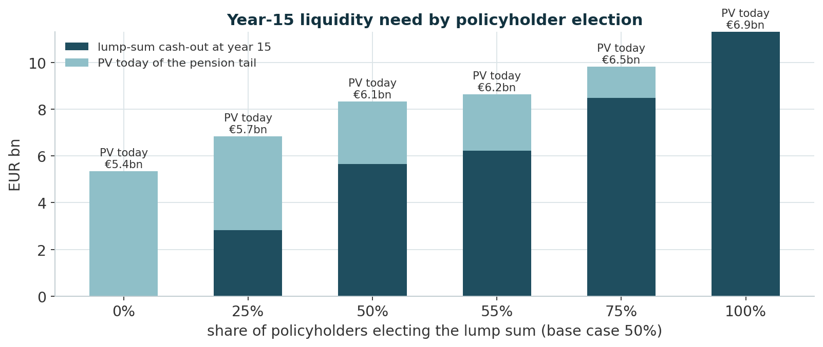
Base Case and Policyholder-Choice Sensitivity
18
How the year-15 liquidity need moves with the lump-sum election rate
LIABILITY SPLIT BY ELECTION
Lump
Cash-out yr 15
PV today
0%
€0.0bn
€5.35bn
25%
€2.83bn
€5.75bn
50% (base)
€5.65bn
€6.14bn
75%
€8.48bn
€6.54bn
100%
€11.30bn
€6.94bn
Base case: even 50/50 split (assignment gives the choice; we stress ±25pp). Source: mixed_liability_scenarios.xlsx.
CLIENT SITUATION | OUR SELLING POINTS | STRATEGIC CHALLENGES & MARKET OVERVIEW | PRODUCT STRATEGY | PORTFOLIO RESULTS | WHAT HAPPENS WITH THE UPSIDE

Slide 24
Portfolio Architecture – Two Sleeves, One Mandate
19
Segregating the guaranteed floor from the surplus-return assets
ARCHITECTURE
Liability-Matching Portfolio (LMP)
Return-Seeking Portfolio (RSP)
• €5.0bn bond book, cash-flow + key-rate matched to the 1.0% guarantee.
• Small, by-design funding risk.
• Contributions (€0.5bn/yr) invested in an aggressive, diversified index mix.
• Captures the upside above the floor; a bad year never touches the guarantee.
Why split
What sets the split
• Standard insurance ALM – return risk can never endanger the floor.
• Each sleeve judged on its own mandate; funded status transparent at any time.
• Not a fixed %: the LMP is sized to the PV of the guaranteed liability.
• Everything above the funded amount flows to the RSP; the split re-strikes yearly.
CLIENT SITUATION | OUR SELLING POINTS | STRATEGIC CHALLENGES & MARKET OVERVIEW | PRODUCT STRATEGY | PORTFOLIO RESULTS | WHAT HAPPENS WITH THE UPSIDE

Slide 25
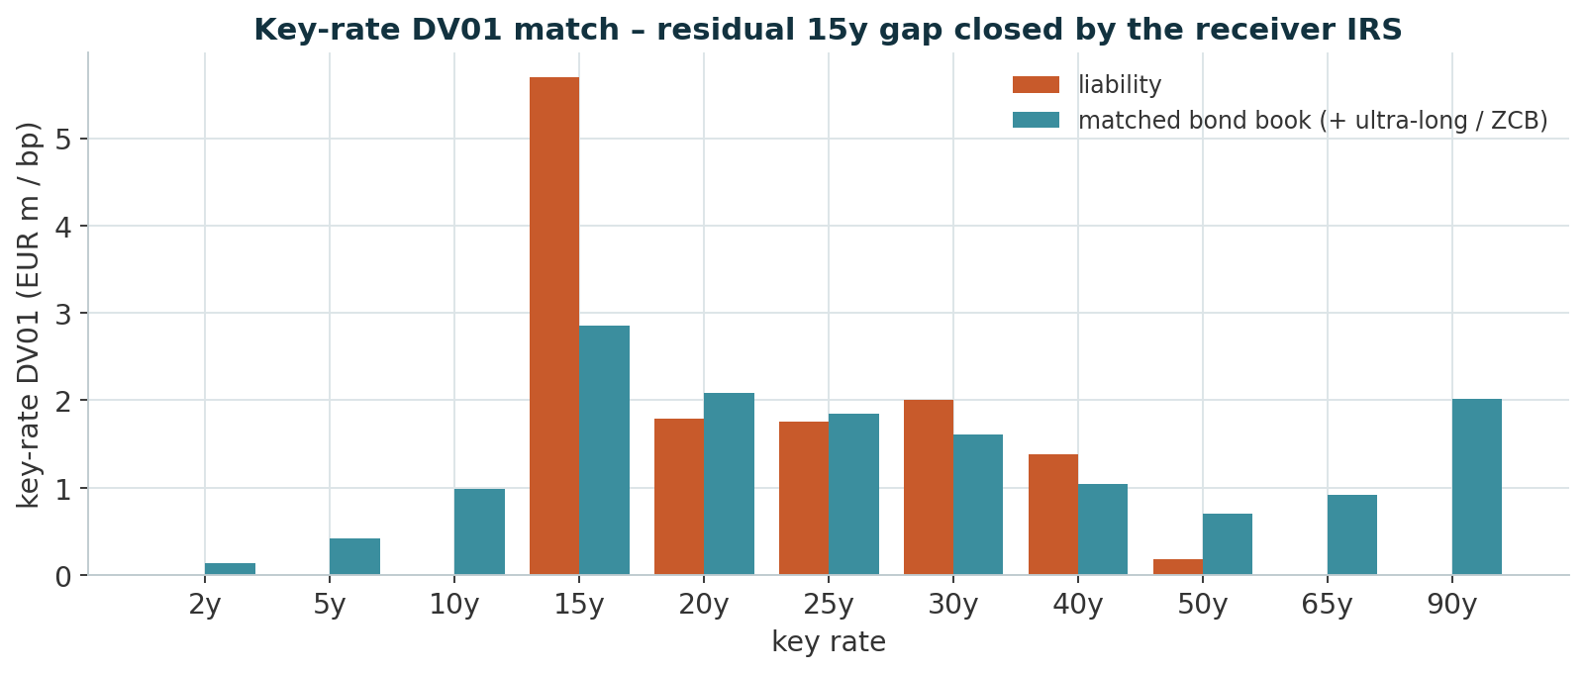
Liability-Matching Portfolio – Bonds, Precisely Matched
20
Cash-flow dedication, key-rate DV01 shaping, and a no-cash receiver-IRS overlay
HOW THE MATCH IS BUILT
Four techniques
• Cash-flow dedication. Stage 1: running cash balance ≥ 0 every year (1.5% reinvestment) – external top-up €0.00bn, covered to year 50.
• Duration matching. ≈ 29y KRD-effective, matched to the ≈ 20y / €12.8m-per-bp liability.
• Key-rate DV01. Stage 2: match € per bp at each tenor, without giving back Stage-1 coverage or duration.
• Receiver-IRS overlay. Par swap, notional not exchanged – no cash. 15y €2.8bn + 30y €0.3bn closes the residual 15y gap.
11 bonds, ≈ €5.0bn
KRD-eff. duration ≈ 29y
cash-flow top-up €0.00bn; surplus DV01 gap ≈ 0 after IRS
Source: results_v2/portfolio_wide.csv (two-stage: Stage 1 cash-flow dedication, Stage 2 KRD shaping) + cashflow_match_v2.size_irs().
CLIENT SITUATION | OUR SELLING POINTS | STRATEGIC CHALLENGES & MARKET OVERVIEW | PRODUCT STRATEGY | PORTFOLIO RESULTS | WHAT HAPPENS WITH THE UPSIDE

Slide 26
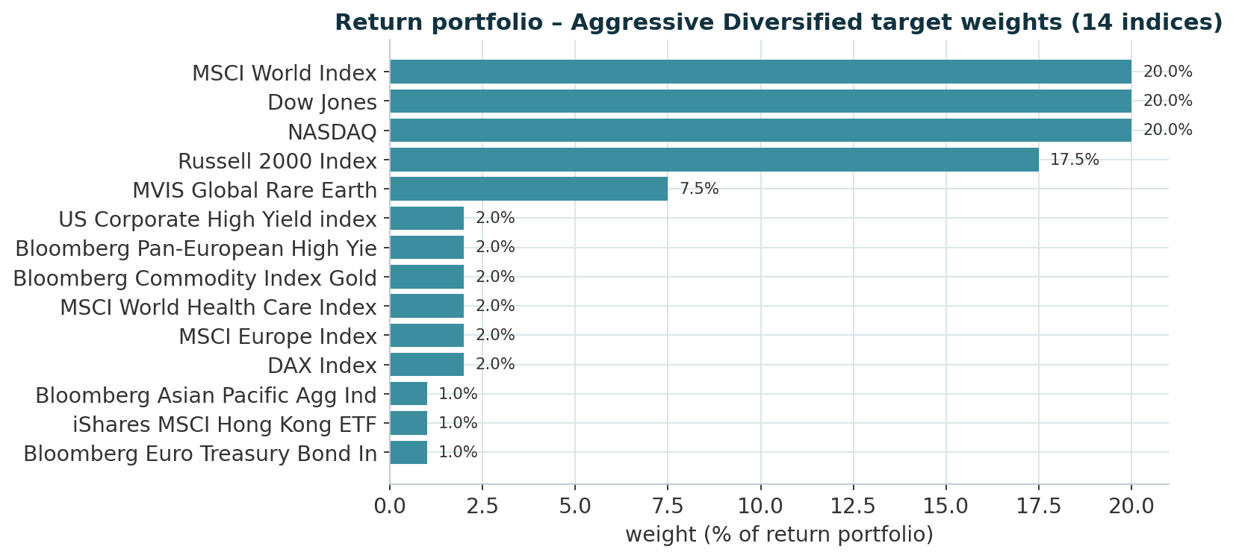
Return-Seeking Portfolio – Equities for the Surplus
21
Aggressive Diversified target weights across 14 investable indices
TARGET WEIGHTS
Rationale
• ≈ 92% equity across DAX, Nasdaq, Dow, MSCI World / Europe, Russell 2000, Asia-Pacific, plus rare-earth, health-care and Hong Kong satellites.
• ≈ 4% high yield, ≈ 2% gold, ≈ 1% euro treasuries for diversification.
• Risk calibrated to surplus only – the guarantee is already secured by the LMP.
Source: portfolio_optimization_final.xlsx, sheet 'Portfolio Weights', column Aggressive_Diversified.
CLIENT SITUATION | OUR SELLING POINTS | STRATEGIC CHALLENGES & MARKET OVERVIEW | PRODUCT STRATEGY | PORTFOLIO RESULTS | WHAT HAPPENS WITH THE UPSIDE

Slide 27
Investment Rationale – Why These Building Blocks
22
Tying the two-sleeve architecture back to the quantified liability
LMP VS RSP
Liability-Matching Portfolio
Return-Seeking Portfolio
Job
match the 1.0% guarantee, minimal tracking error
capture the surplus – target ≈ 6% p.a. median IRR
Instruments
EUR sovereign / SSA / covered bonds + ultra-long & zero-coupon
broad developed + satellite equity indices, some HY / gold
Protects against
funding risk on the guarantee – the one liability we cannot get wrong
missing the return that makes the mandate worth running
• A single blended portfolio would force every decision to compromise between safety and return – under-funding the guarantee or under-delivering the target.
• Every instrument screened for Solvency II capital, liquidity, diversification and implementation.
• A board can explain it in one line: the floor is matched, the upside is diversified.
CLIENT SITUATION | OUR SELLING POINTS | STRATEGIC CHALLENGES & MARKET OVERVIEW | PRODUCT STRATEGY | PORTFOLIO RESULTS | WHAT HAPPENS WITH THE UPSIDE

Slide 28
The Investable Universe
23
One universe, two mandates
BY SLEEVE
Fixed income
Equity indices (RSP)
Diversifiers (RSP)
• LMP: EUR government & SSA bonds (KfW, EU, Belgium, Austria, Netherlands, Germany), covered bonds, ultra-long and zero-coupon (STRIPS).
• RSP credit: US corporate HY, Pan-European HY.
• DAX, Dow Jones, Nasdaq, MSCI World, MSCI Europe, Russell 2000, Bloomberg Asia-Pacific Aggregate.
• Satellites: MVIS Global Rare Earth, MSCI World Health Care, iShares MSCI Hong Kong.
• Bloomberg Commodity – Gold.
• Bloomberg Euro Treasury (liquid ballast).
Source: portfolio_optimization_final.xlsx (14-index optimiser universe); Fixed Income Basket.xlsx + ZCB and ultra long coupon Bond.xlsx.
CLIENT SITUATION | OUR SELLING POINTS | STRATEGIC CHALLENGES & MARKET OVERVIEW | PRODUCT STRATEGY | PORTFOLIO RESULTS | WHAT HAPPENS WITH THE UPSIDE

Slide 29
SECTION 05
Portfolio Results
Does it work? 1-year 99% VaR, deterministic stress, 15-year Monte-Carlo

Slide 30
Risk Map – What All-Kanns Is Exposed To
24
Four risks fall out of the strategy; each gets the same three questions
FOUR RISKS
1 Interest-rate / duration risk
Rate moves reprice both the LMP and the liability – the risk is the mismatch between them.
2 Equity & market risk
The RSP's core exposure – accepted deliberately, on surplus capital only.
3 FX exposure
USD sleeves (US Treasuries, US equity, USD credit) create currency risk against a EUR guarantee.
4 Longevity & election risk
How long survivors live, and how many take the pension over the lump sum.
For each: why it arises · how large (quantified) · accept, mitigate or transfer.
CLIENT SITUATION | OUR SELLING POINTS | STRATEGIC CHALLENGES & MARKET OVERVIEW | PRODUCT STRATEGY | PORTFOLIO RESULTS | WHAT HAPPENS WITH THE UPSIDE

Slide 31
Risk Quantification and Response
25
For each risk: why it matters, how large it is, what we do
QUANTIFIED (1-YEAR, CURRENT BOOK)
Risk
How large (quantified)
Response
Rate / duration
±100bp: LMP ≈ €1.05bn vs liability ≈ €1.22bn; surplus swing ≈ €0.16bn with the KRD + IRS match (≈ €0.53bn without the IRS)
Mitigate – cash-flow + KRD + receiver IRS
Equity / market
−30% equities ≈ −€1.41bn on the RSP – inside the €3.2bn economic surplus
Accept – the deliberate risk budget
FX
USD sleeves swapped to EUR; residual is the 1y rate-differential on the hedge roll
Mitigate – FX-swap the LMP; RSP partly unhedged as a diversifier
Longevity / election
25%→75% lump swing moves the year-15 need €2.8bn→€8.5bn; +1yr life exp ≈ +€0.27bn liability
Mitigate via buffer sizing; reinsurance available
Source: results_var/stress_tests_full_irs.csv & _unhedged.csv; results/policyholder_choice_scenarios.csv.
CLIENT SITUATION | OUR SELLING POINTS | STRATEGIC CHALLENGES & MARKET OVERVIEW | PRODUCT STRATEGY | PORTFOLIO RESULTS | WHAT HAPPENS WITH THE UPSIDE

Slide 32
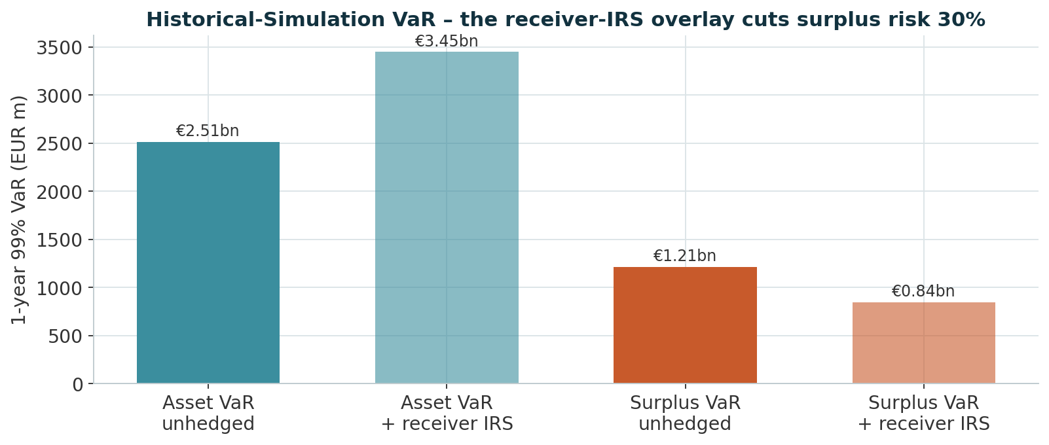
Does It Work? One-Year 99% VaR and Surplus Risk
26
The mandated internal measure: 1-year 99% VaR on asset P&L and on surplus P&L
1-YEAR 99% VAR – HISTORICAL SIMULATION
Method
• 468 overlapping 52-week windows of real factor history; rates as absolute changes, indices as log returns.
• Non-normality kept: empirical tails + a Student-t / Heston Monte-Carlo cross-check.
Asset VaR
€2.51bn
25.1% of assets
Surplus VaR (unhedged)
€1.21bn
17.8% of liab. PV
Surplus VaR (+ IRS)
€0.85bn
8.5% of assets
MC surplus VaR (t / Heston)
€1.81bn
fatter tails
Surplus P&L = ΔAssets − ΔLiability. Source: results_var/HS_REPORT_full_*.md, MC_REPORT_mc_full.md.
CLIENT SITUATION | OUR SELLING POINTS | STRATEGIC CHALLENGES & MARKET OVERVIEW | PRODUCT STRATEGY | PORTFOLIO RESULTS | WHAT HAPPENS WITH THE UPSIDE

Slide 33
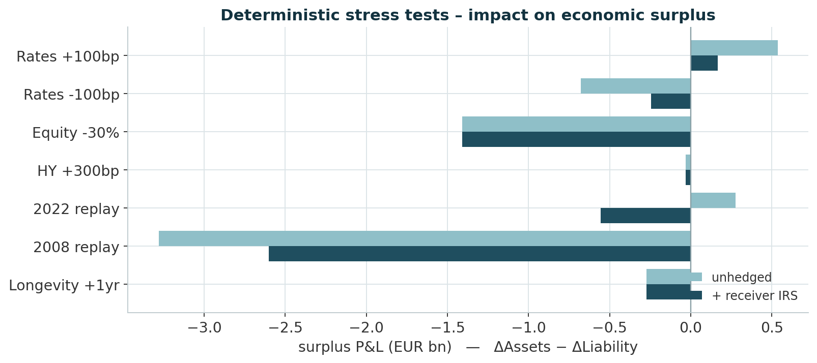
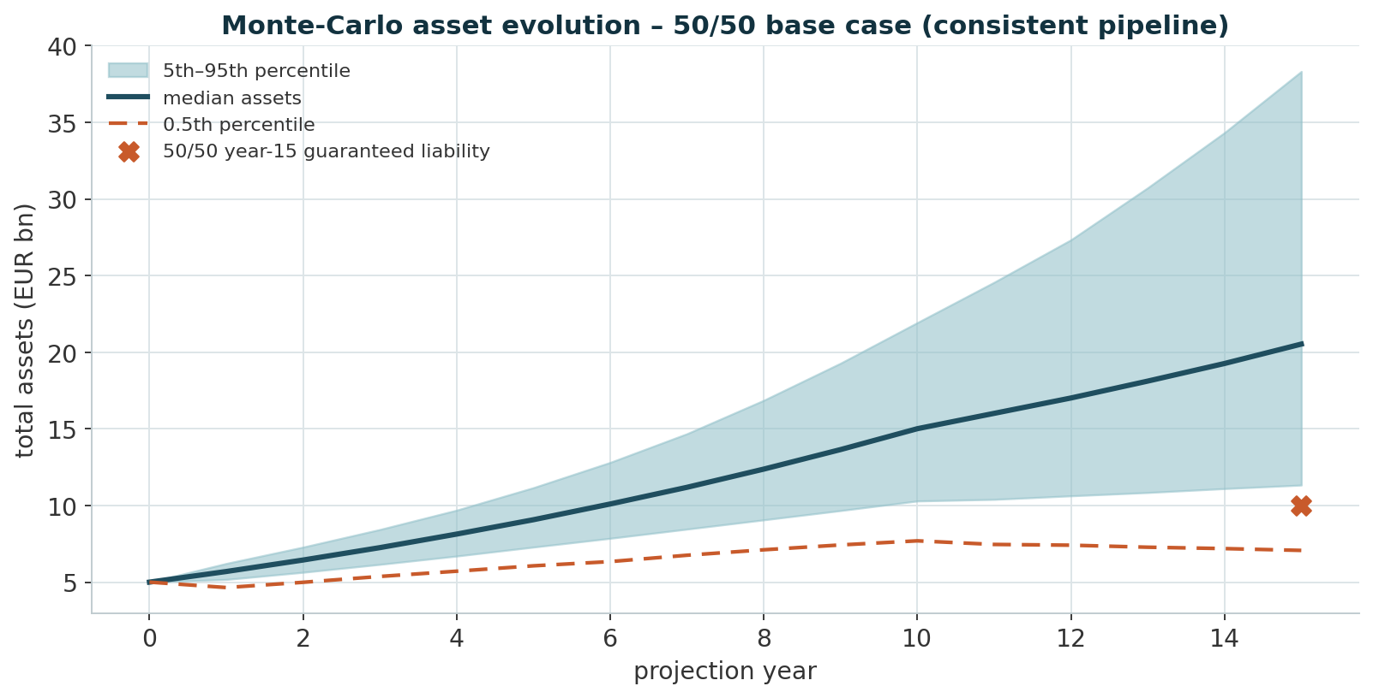
Stress Testing and 15-Year Monte-Carlo
27
Deterministic scenarios on the surplus, and the full distribution at year 15
DETERMINISTIC STRESS + 15-YEAR MONTE-CARLO (CONSISTENT PIPELINE)
MEDIAN ASSETS, YR 15
5TH PERCENTILE
0.5TH PERCENTILE
P(UNDERFUNDED), 50/50
€20.5bn
€11.3bn
€7.1bn
≈ 2.5%
median funded ratio 205%
still above the €10.0bn liability
the genuine tail – below the floor
15y horizon, before the glidepath
Sources: results_var/stress_tests_full_*.csv; mc_lifecycle.py (50k paths, annual Student-t df 5, the actual funding waterfall). 15Y median IRR ≈ 5.9%.
CLIENT SITUATION | OUR SELLING POINTS | STRATEGIC CHALLENGES & MARKET OVERVIEW | PRODUCT STRATEGY | PORTFOLIO RESULTS | WHAT HAPPENS WITH THE UPSIDE

Slide 34
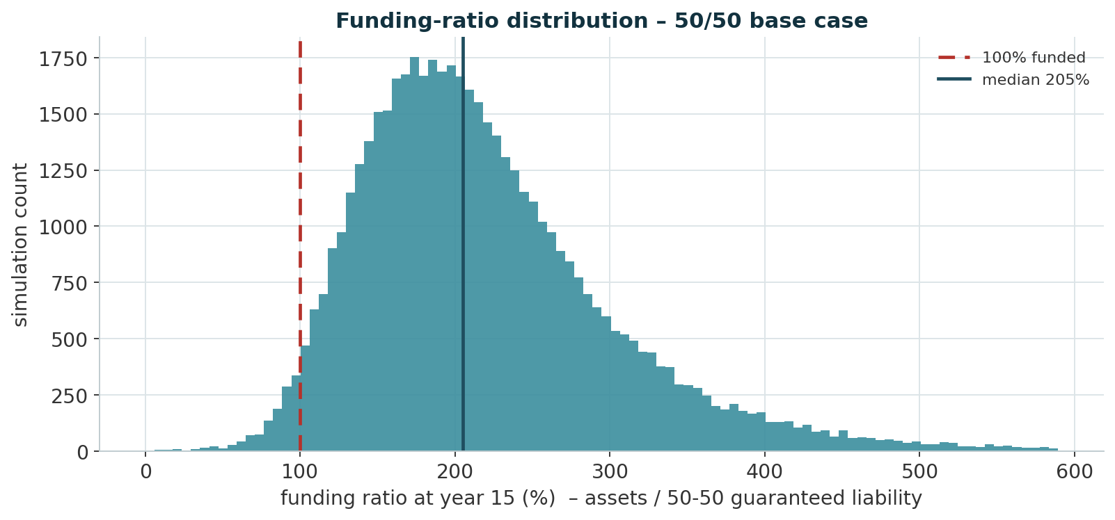
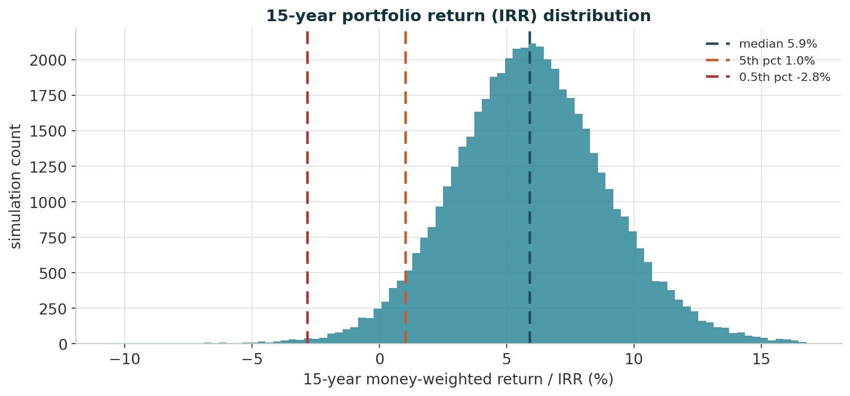
15-Year Monte-Carlo – Does It Reach the Destination?
28
Consistent pipeline: the real funding waterfall, Student-t returns, 50,000 paths
YEAR-15 OUTCOME DISTRIBUTIONS
MEDIAN FUNDED RATIO
MEDIAN 15Y IRR
P(UNDERFUNDED), 50/50
MEAN ANNUAL RETURN
205%
5.9%
≈ 2.5%
6.3%
assets / 50-50 year-15 liability
5th pct 1.0%, 0.5th pct −2.8%
rises to ≈ 5% at a 100% lump election
contribution-stripped
The tail is fatter than an assumed 70/30 blend: the waterfall loads the volatile RSP far more heavily by year 15. Source: mc_lifecycle.py / results_var/MC_LIFECYCLE_REPORT.md.
CLIENT SITUATION | OUR SELLING POINTS | STRATEGIC CHALLENGES & MARKET OVERVIEW | PRODUCT STRATEGY | PORTFOLIO RESULTS | WHAT HAPPENS WITH THE UPSIDE

Slide 35
SECTION 06
What Happens With the Upside
The cash-flow structure, the flows under every election scenario, and the 90/10 share

Slide 36
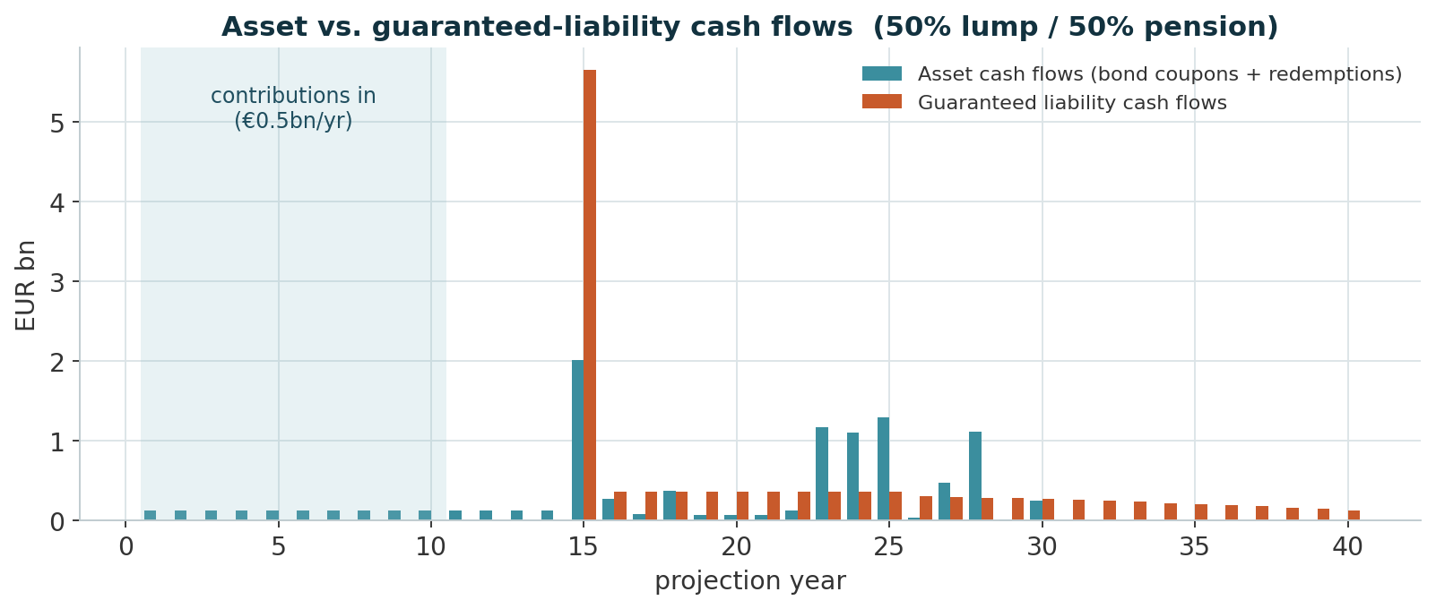
The Cash-Flow Structure
29
Contributions in for 10 years; a year-15 spike, then a 35-year pension tail
ASSET VS. GUARANTEED-LIABILITY CASH FLOWS
Reading the structure
• Years 1–10. €0.5bn/yr contributions fund the RSP; the LMP coupons accrue.
• Year 15. the lump-sum spike – €5.65bn at 50/50 (€2.3–9.0bn across the election).
• Years 16–50. ≈ €0.3bn/yr pension tail, decaying with mortality; 11% of PV beyond year 30.
• Coverage. Stage-1 dedication keeps the running cash balance ≥ 0 every year to year 50 – no external top-up; ultra-long / zero-coupon bonds reach the 30y+ tail.
Years 1–10
+ €0.5bn / yr contributions
→ Return portfolio
Year 15
− €5.65bn lump sum (50/50)
→ safe sleeve
Years 16–50
− ≈ €0.3bn / yr pension tail
→ coupons + reinvestment
CLIENT SITUATION | OUR SELLING POINTS | STRATEGIC CHALLENGES & MARKET OVERVIEW | PRODUCT STRATEGY | PORTFOLIO RESULTS | WHAT HAPPENS WITH THE UPSIDE

Slide 37
Flows Under Every Scenario
30
The year-15 need and the pension tail move with the election; the surplus absorbs the market path
POLICYHOLDER-ELECTION SCENARIOS
Election
Lump-sum at yr 15
Pensioners
Pension PV at yr 15
Total PV today
0% lump / 100% pension
€0.0bn
100,000
€8.72bn
€5.35bn
25% / 75%
€2.83bn
75,000
€6.54bn
€5.75bn
50% / 50% (base case)
€5.65bn
50,000
€4.36bn
€6.14bn
75% / 25%
€8.48bn
25,000
€2.18bn
€6.54bn
100% / 0%
€11.30bn
0
€0.00bn
€6.94bn
Market path on top
So the upside is real – with a real tail
• Base 15y median assets €20.5bn vs a €10.0bn liability → median funded ratio ≈ 2.05×.
• 5th-pct path €11.3bn still covers it; the 0.5th-pct path (€7.1bn) does not.
• ≈ 97.5% of paths finish funded at the base election (P(underfunded) ≈ 2.5%), ≈ 95% at a 100% lump election.
• The deep tail is the RSP's – the €5bn LMP still backs the guaranteed cash flows; the years 11–15 glidepath de-risks it further.
Source: mixed_liability_scenarios.xlsx (Scenario Summary); mc_lifecycle.py (50k paths, consistent funding waterfall).
CLIENT SITUATION | OUR SELLING POINTS | STRATEGIC CHALLENGES & MARKET OVERVIEW | PRODUCT STRATEGY | PORTFOLIO RESULTS | WHAT HAPPENS WITH THE UPSIDE

Slide 38
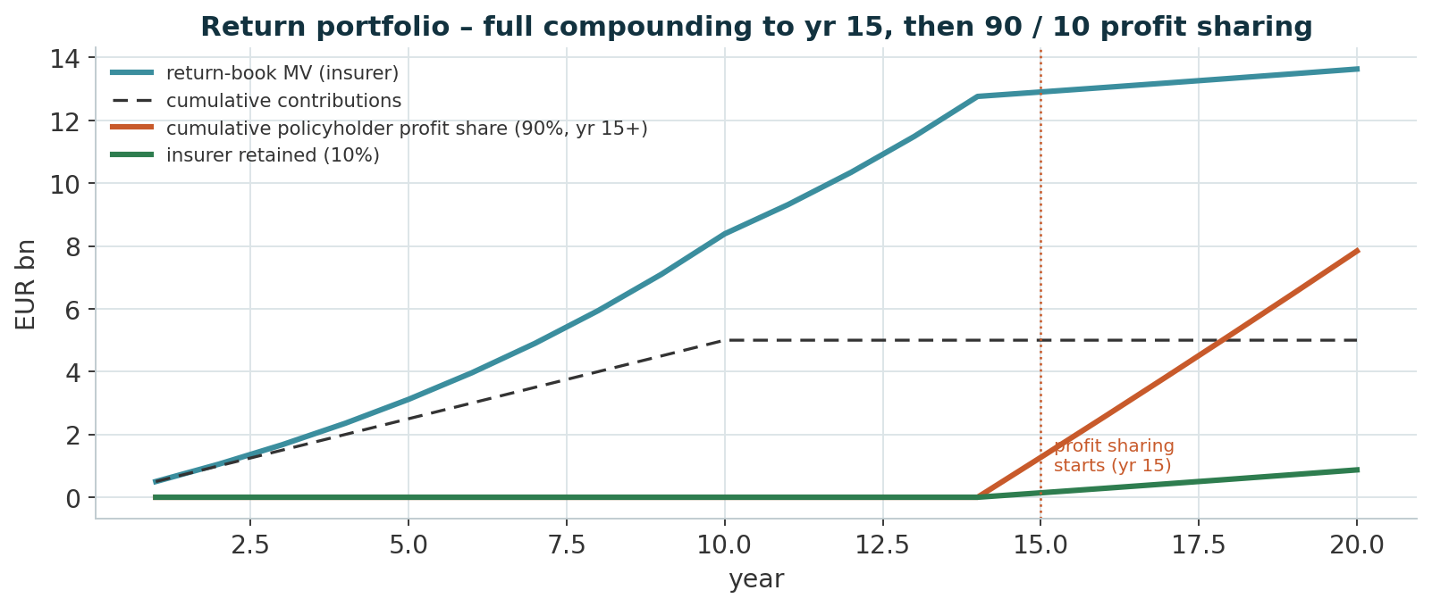
Sharing the Upside – 90 / 10 From Year 15
31
The whole return compounds until benefits begin; then 90% of profit goes to policyholders
WHERE THE SURPLUS GOES
Mechanics
• Years 1–14: no sharing. the whole investment return compounds in the book – contributions €5.0bn → return-book MV ≈ €8.4bn by year 10.
• Year 15+: 90 / 10. 90% of each year's investment profit paid to policyholders (equal EUR sold from every sleeve), 10% retained and reinvested; losses carry forward first.
• Payout phase (yr 15–20). ≈ €7.8bn cumulative to policyholders, ≈ €0.9bn retained; book ≈ €13.6bn at year 20 (deterministic-return projection).
• Guarantee untouched. the 90% is a pass-through off the insurer's asset side – it never draws on the LMP.
Source: return_book.py (profit_share_start_year = 15). Headline VaR uses the conservative flat €5.0bn return book; the projected €8.4bn book is the 'full_projected' sensitivity (assets €13.4bn, Surplus VaR €1.42bn).
CLIENT SITUATION | OUR SELLING POINTS | STRATEGIC CHALLENGES & MARKET OVERVIEW | PRODUCT STRATEGY | PORTFOLIO RESULTS | WHAT HAPPENS WITH THE UPSIDE

Slide 39
Key Selling Points and Recommendations
32
What we propose, and why All-Kanns should mandate it
RECOMMENDATION
What we propose
Why it wins the mandate
• Split the book. €5.0bn into a cash-flow + key-rate matched LMP; contributions into the Aggressive Diversified RSP; re-strike the split yearly.
• Add a receiver-IRS overlay. 15y €2.8bn + 30y €0.3bn, par, notional not exchanged – no cash, only variation margin.
• Extend the LMP. ultra-long and zero-coupon (STRIPS) bonds to reach the 20y+ liability without breaching the 15% instrument cap.
• Swap USD → EUR on every sleeve; leave part of the RSP unhedged as a diversifier.
• Glidepath years 11–15 de-risk into the year-15 payout; hold ≥ 1.1× the next 12m of outflows in cash + sovereigns.
• Floor is backed. the €5bn cash-flow-dedicated LMP funds the guaranteed benefits directly; ≈ 97.5% of 15-year MC paths finish funded at the base election (P(underfunded) ≈ 2.5%), the glidepath cuts the tail further.
• Upside is real. median 15-year IRR ≈ 5.9% – ≈ 490bps above the 1.0% guarantee; 90% shared with policyholders from year 15.
• Risk is controlled. 1-year 99% surplus VaR €0.85bn after the overlay (−30%); every stress inside the €3.2bn surplus.
• IAS-defensible. duration + KRD matched, so LMP mark-to-market offsets the liability; low turnover.
• Fully compliant. Solvency II capital and BaFin AnlV limits built into construction and reporting.
One line for the board: the floor is matched, the upside is diversified and shared, and the residual risk is hedged for no cash.
CLIENT SITUATION | OUR SELLING POINTS | STRATEGIC CHALLENGES & MARKET OVERVIEW | PRODUCT STRATEGY | PORTFOLIO RESULTS | WHAT HAPPENS WITH THE UPSIDE

